Slide 1
Representation Learning: Compositionality and Disentanglement

Slide 2
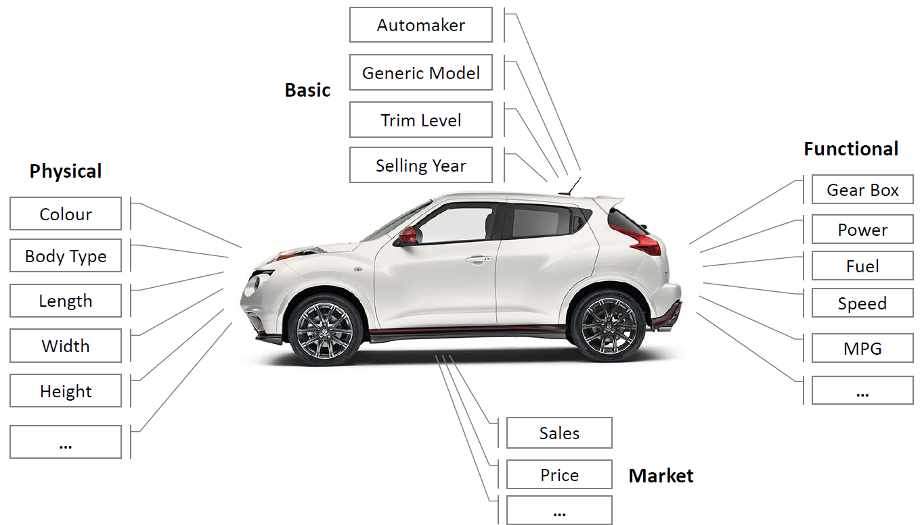
Representations as Attributes
The representations we described so far are quite abstract
Evaluated by downstream task performance
Here, we think of representations as consisting of attributes

Slide 3
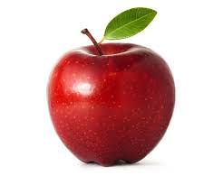
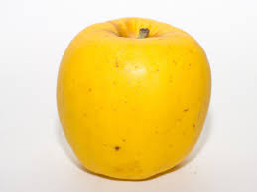
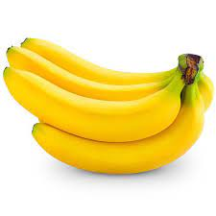
Compositionality in ML
Given a dataset where each image has two labels, fruit type and color
Assume in the dataset we see either red apples or yellow bananas
At test, we see a yellow apple
We ask: “what fruit is it?”

Slide 4
Ways to Overcome It
Need more information – different methods for injecting it:
Option 1: biasing architecture to differentiate between attributes
Option 2: reducing bias e.g. seeing many (color, fruit) combinations

Slide 5
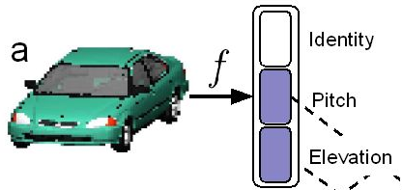
Disentanglement
Disentangled representation:
Each dimension is informative over at most a single attribute
Every attribute is predictable from the representation

Slide 6
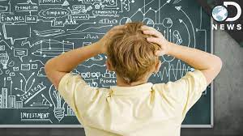
Disentanglement Entails Compositionality
Disentanglement is harder compositionality – entails it
Trivial: every attribute is representated by different dimensions
Compositionality: problem biased datasets
Disentanglement: problem even in unbiased datasets

Slide 7
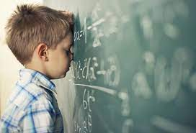
Disentanglement Entails Classification
Disentanglement is harder than classification
Trivial: every attribute is represented spearately

Slide 8
Quest for Unsupervised Disentanglement
Unsupervised disentangled representations – holy grail of SSL
This is probably impossible
Assumes we get a bunch of unlabeled images and classify all attributes without supervision – too good to be true

Slide 9
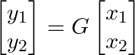
Identifibility in the Linear Setting
Assume we have two attributes x₁, x₂ – which are not observed
Pass through a linear generative process G – physics of the world
G is invertible by unknown
Observe
Can we identify G and thus recover the true x₁, x₂?

Slide 10
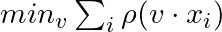
Independent Component Analysis (ICA)
ICA observes that x₁,x₂ unidentifiable if they are Gaussian (Why?)
Instead, it assumes x₁,x₂ are highly non-Gaussian, independent
Main idea – combination of non Gaussians is less non-Gaussian
Greedily recovers the most non-Gaussian combination of y₁, y₂
Different non-Gaussianity measures can be used

Slide 11
Nonlinear Identifiability Results
There is a body of theory examining when attributes are recoverable
G non-linear, x and G are unknown
Indentifiability guranteed only in very limited settings
Out of scope for this course – very interesting if you like maths!

Slide 12
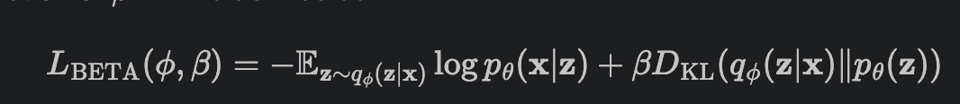
BetaVAE for Unsupervised Disentanglement
BetaVAE: normal VAE but with larger weight (beta) on the KL term
Intuition: makes the latent codes more Gaussian
More Gaussian means more independent
Locatello et al. showed this does not work in general (why?)

Slide 13
How to Evaluate Disentanglement - DCI
Latent code with 10 dims
Assume there are K factors of variation
Expect: one latent code for every factors, 10 – K empty codes
DCI metrics:
Completeness – each factor described by at least 1 code dim
Disentanglement – each code dim correlated with at most 1 factor
Informaticeness – all factors are described by code

Slide 14
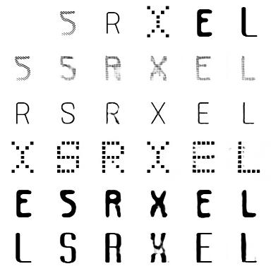
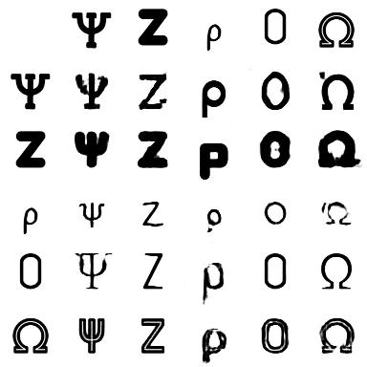
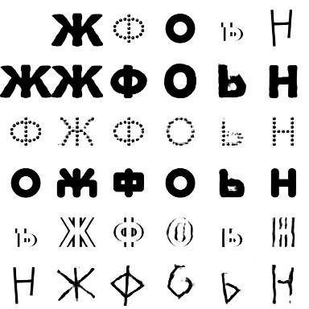
Conditional Disentanglement
Unsupervised disentanglement may be too hard
Let’s tackle a different setting – conditional disentanglement
Every image x is also labeled with its condition c
This can really be any attribute e.g. pose, car model, painting/photo
Glyph
Font
English
Greek
Russian

Slide 15
VAE for Conditional Disentanglement
Choose a prior such that p(z|c) = N(0, I)
Reminder – the ELBO is given by:
As p(z) = sum_c p(z|c)p( c) = p(z|c), z does not depend on c
The combination of z, c must represent all attributes in x
Independence + completeness -> z includes all attributes but x

Slide 16
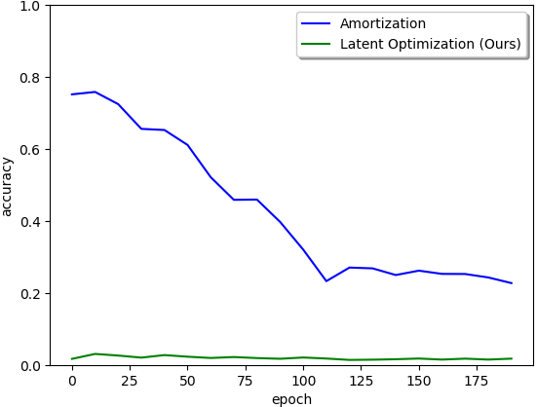
Amortized VAE: Bad for Disentanglement
The core idea in VAE was using an encoder to predict q(z|x) given x
Consider what happens at initilization, encoder has random weights
Latent code contains random combination of attributes – entangled
While training loss enforces disentanglement, z does not recover

Slide 17
LORD: Latent Optimization is King
For each image: optimize the expectation mu_x of p(z|x) = N(mu_x, s)
As each mu_x is initialized randomly, independent of c
During training mu becomes more informative on x, but still not on c

Slide 18
Does This Solve Disentanglement?
Identifiably of the unknown attributes is still not guranteed!
This is not hard to see: for images of (apples, bananas), (red, yellow)
Every image is tagged with color (c) but not fruit
LORD ensures that (z, c) describe all attributes, and z,c independent
Both options are feasible solutions, but only the first is helpful
 | c = red | c = yellow
z=0 | apples | apples
z=1 | bananas | bananas
 | c= red | c = yellow
z=0 | apples | bananas
z=1 | bananas | apples

Slide 19
Why Does LORD Work in Practice?
Inductive bias - magic of CNNs
While multiple solutions are feasible they prefer the correct one
This is clearly not always going to be true!
Occurs in many interesting cases though
https://github.com/avivga/lord-pytorch

Slide 20
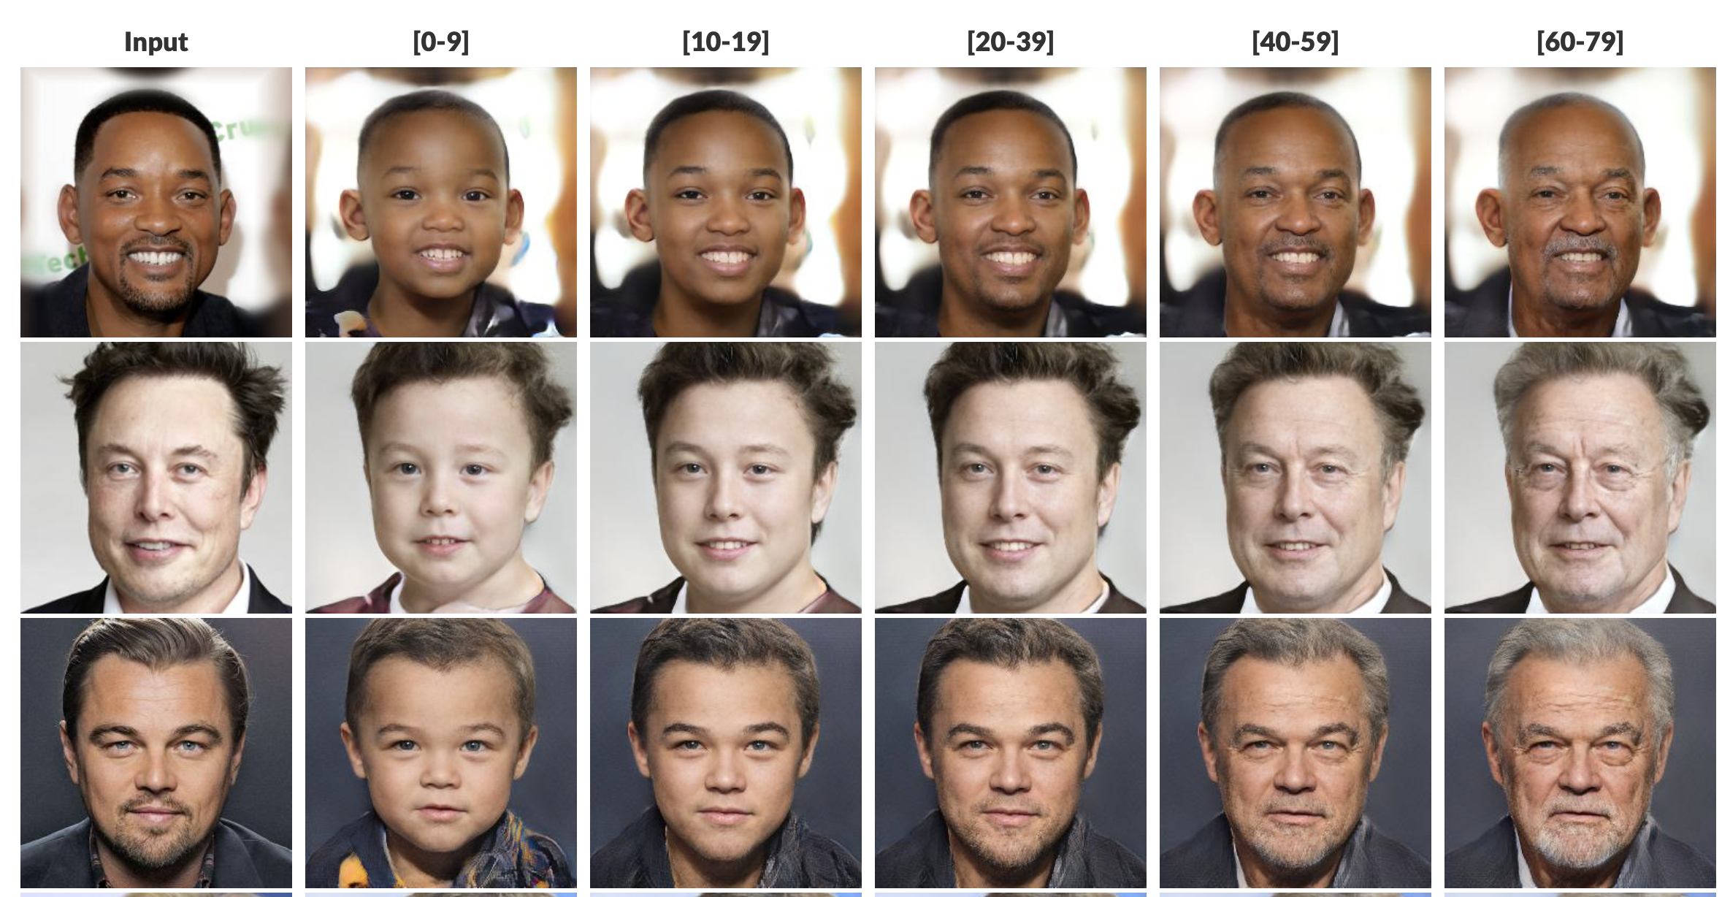
Age Transfer using LORD

Slide 21
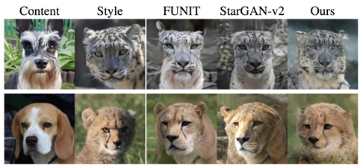
Benefits of Correct Disentanglement
Non-disentangled representations mix different conditions (species)

